Slide 1
Smoke Detector and Intensity Measure

Slide 2

Assalamualaikum!
We are here because we have made smart smoke detector.

Slide 3
Introduction
Uncontrolled fires are responsible for many harmful damages and human losses. Also, the available smoke detectors used in institutions and companies are very sensitive and respond to cigarette smoke and give false alarm.
We have proposed an algorithm by using 2xESP32 and FreeRTOS open- source kernel in order to accomplish such task in a reduced scale project

Slide 4
OBJECTIVES
1
Let’s discuss why we need this ??

Slide 5
My cooking is so fabulous…
Even the smoke Alarm cheers me on.

Slide 6
Objectives
There are plenty of fire alarm projects installed in buildings and industries, including different devices and technologies. these projects are often outdated and require improvements.
A hard real-time system for fire alarm and fire suppression is proposed in a reduced scale to improve the performance of the time response.

Slide 7
Componenets
2

Slide 8

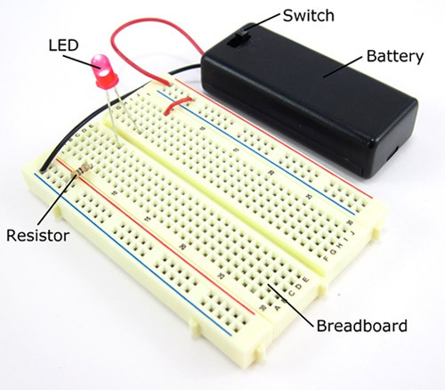

Component s
5V Buzzer

Slide 9
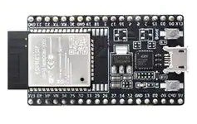
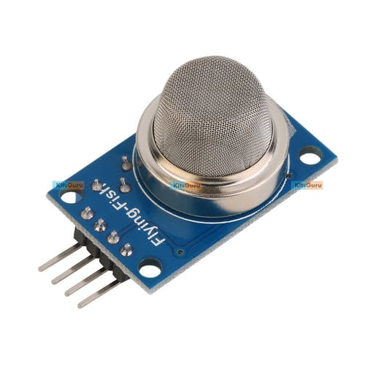
MQ2 Smoke Sensor And 2x ESP32
ESP32
Operating Voltage is +3.6V
Have 36 ports
16MB of Flash Memory
2.4 GHz WiFi
Clock Speed of upto 240MHz
MQ2 Sensor
Operating Voltage is +5V
Can be used to Measure or detect LPG, Alcohol, Propane, Hydrogen, CO and even methane
Output voltage: 0V to 5V
Preheat duration 20 seconds

Slide 10



Block Diagram
Presence of gas and smoke above threshold
MQTT
Signal received
Signal sent via wireless
Buzzer
Smoke detector
Activate Buzzer and LED
Daughter MCU
ESP32
Mother MCU
ESP32
Absence of gas and smoke

Slide 11
Design Methodology
Arduino IDE platform using the FreeRTOS libraries
3 Threads and 1 Semaphore
Wireless Communication Through MQTT

Slide 12
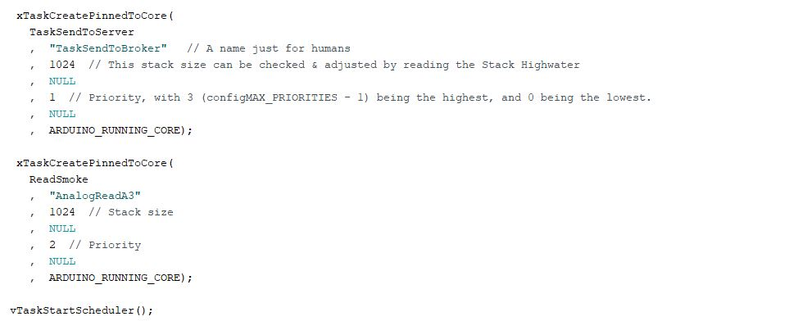
USE OF FREETOS

Slide 13
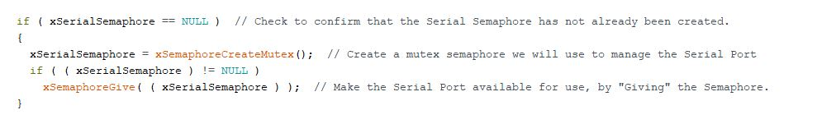
SEMAPHOR CREATION

Slide 14
THANKS!
Any questions?

